Slide 1
A Novel Platform for Localized Intratumoral Expression of Immunotherapy – GET IT
Bridget O’Keeffe

Slide 2
OVERVIEW
Overview of non-viral gene therapy delivery system (gene electro transfer intratumoral therapy – GET IT)
Background and preclinical data supporting melanoma program
Summary and biomarker data from trial of pIL-12 (TAVO) + pembrolizumab in anti-PD-1 resistant melanoma (KEYNOTE-695)
Beyond cutaneous indications: Evolving therapeutic platform for visceral tumors

Slide 3
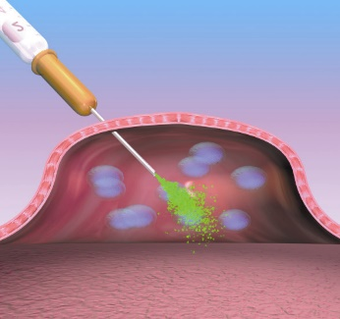
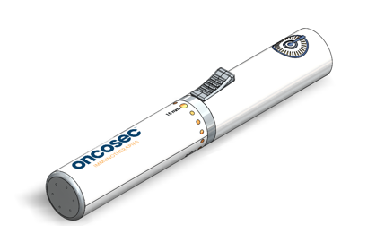
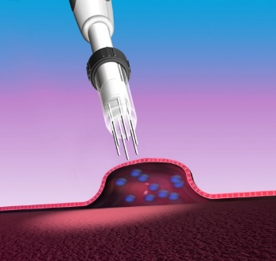
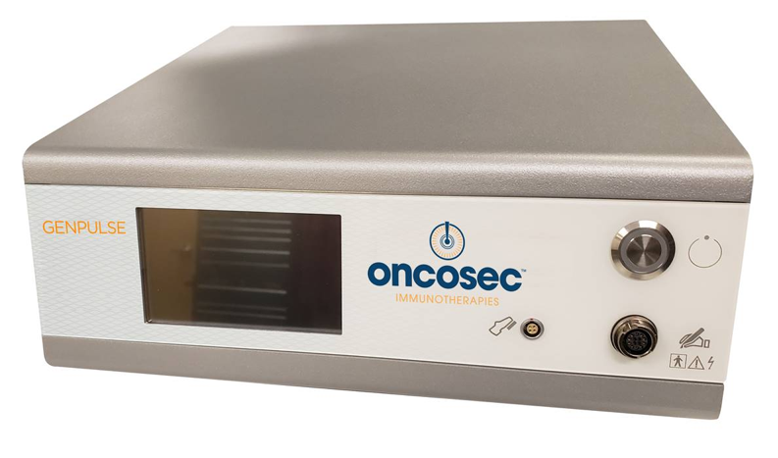
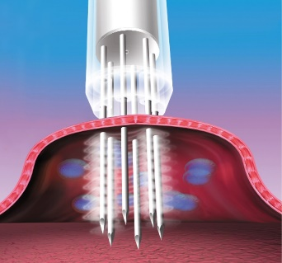
Non-Viral Gene Therapy Delivery System
PROCEDURE
Applicator
Step 1: Injection
Nucleic acid is injected into the tumor
Step 2: Applicator Insertion
Co-localized with the nucleic acid injection
Step 3: Electroporation
Electrical pulses, activated by a foot switch, triggers transfection of cells
0.5 or 1.0 cm in diameter;
Adjustable microneedles, 1 to 15 mm
Genpulse Generator
Transfected cells express nucleic acid targets into the tumor microenvironment
6 x 100 μsec electrical pulses of 1500 V/cm

Slide 4
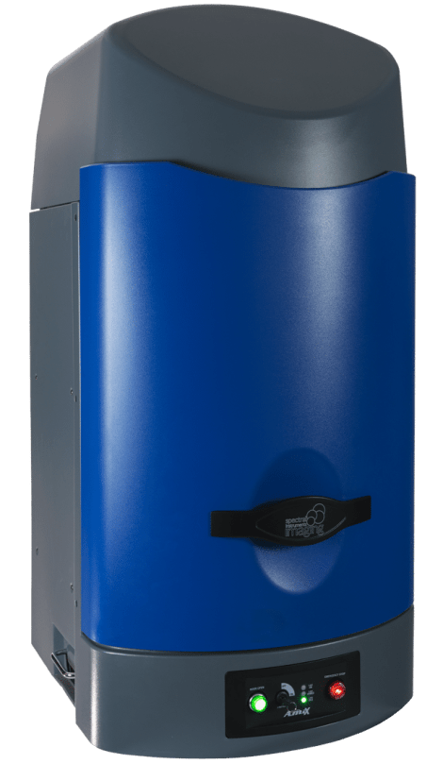
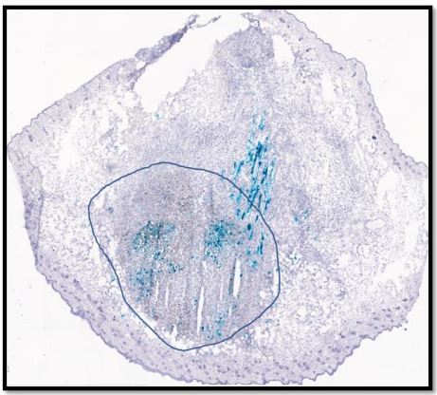
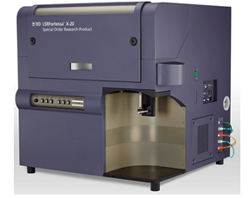
Non-Viral Gene Therapy Delivery System
Payloads can be plasmid DNA or mRNA encoding cytokines, co-stimulatory molecules, antibodies, etc.
In vivo Imaging
pLuciferase
IHC
pLacZ
Dose-response
Tumor extract
mCherry fluorescence
Digested tumor
Plasmid
GET IT is an effective method of intratumoral expression
Modified from Burkart et al, Gene Therapy 2018

Slide 5
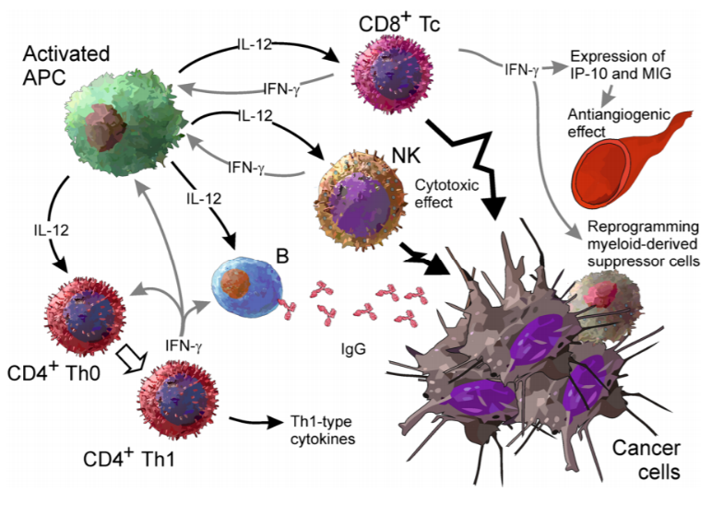
IL-12: Powerful Immunoregulatory Cytokine
Potent, pro-inflammatory heterodimeric cytokine
Drives innate and adaptive immune response
Initiates feedforward loop with IFN-γ and triggers adaptive resistance in the tumor
Can reprogram MDSCs and drive SLECs

Slide 6
Why intratumoral immunotherapies?
Efficient remodeling of the TME with limited toxicity
Relatively high local concentration of an immunostimulatory agent can be achieved in situ
Enables combination therapy, either together or in sequence
Transforms patient’s tumor into a vaccine – generate systemic anti-tumor responses that can be amplified
Prevents significant systemic exposure of toxic molecules, including IL-12
Human Vaccines & Immunotherapeutics 11:8, 1901-1909.

Slide 7
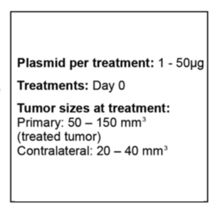
Modeling IL-12 anti-tumor effects in low TIL melanoma model
Treated tumor
Contralateral tumor
A single intratumoral electroporation of pIL-12 shows dose-dependent control of tumor growth in both treated and distant untreated tumors

Slide 8
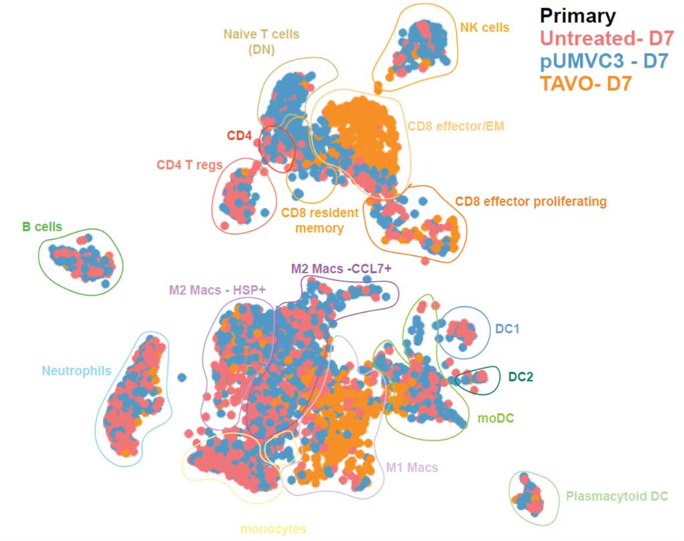
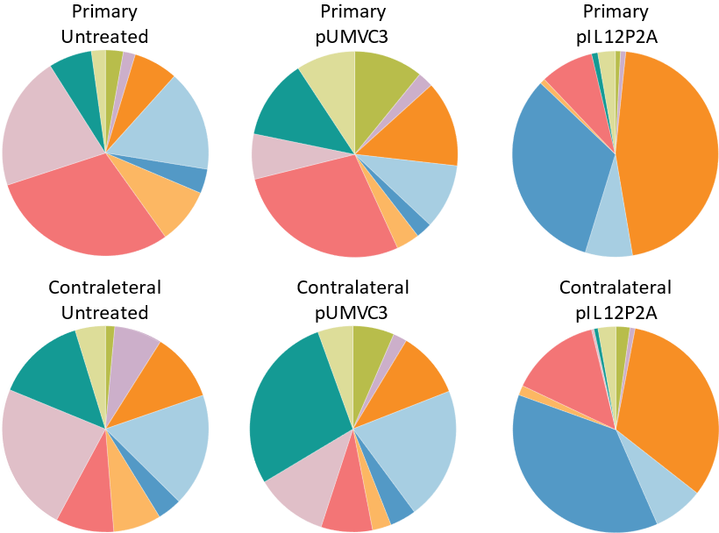
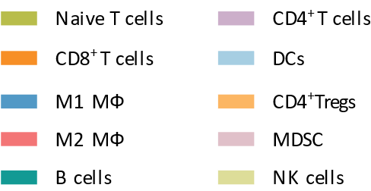
Intratumoral EP of pIL-12 increases tumor immunogenicity
*
*
*
*
*
*
*
*
*
*
IT-pIL12-EP drives an increase in CD8⁺ T cells and M1 macrophage in both injected (primary lesion) and distal non-injected lesions (contralateral lesion).
Fernandez-Peñas, P. et al, SITC 2021
Han M, et al AACR Sp. Conf. 2021

Slide 9
TAVO + anti-PD-1 in patients with stage III/IV melanoma who have confirmed anti-PD-1 progression

Slide 10
Summary of Prior Melanoma Clinical Trials Using TAVO (TAVO = tavokinogene telseplasmid, human pIL-12)
TAVO monotherapy in patients with stage III/IV melanoma (Algazi et al, Ann Oncol 2020)
30% ORR (RECIST v1.1) and regression of at least one untreated lesion was observed in 46% of patients
IL-12 monotherapy drives TIL, activates the immune transcriptome, but induces adaptive resistance
Checkpoint blockade potentially blunted durability of response
TAVO + pembrolizumab in patients with stage III/IV melanoma predicted to not respond to anti-PD-1 therapy (Algazi et al, Clin Cancer Res. 2020)
Enrolled patients had peCTL TIL with <25% CTLA4^{hi}PD1^{hi} (Daud et al , JCI 2016)
43% [9/21] achieved RECIST v1.1 BORR
38% [8/21] achieved RECIST v1.1 durable CR

Slide 11
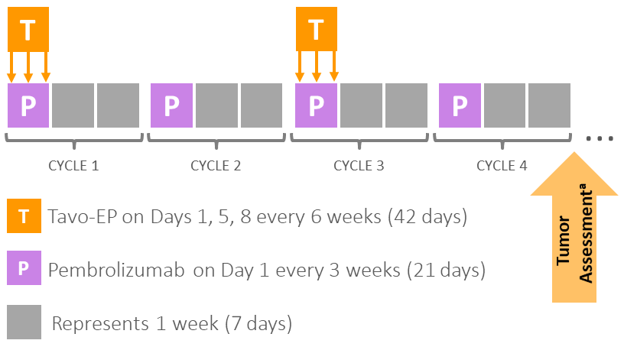

PHASE 2b: TAVO-EP + Pembrolizumab in R/R-Melanoma (KEYNOTE-695)
Study design and conduct
2 L Melanoma
pIL-12 EP + Pembrolizumab
KEYNOTE-695 Patients
Treatment Schedule
KEYNOTE-695 Key Endpoints
  Anti-PD-1 Ab refractory defined as:
    4 doses pembrolizumab q3 weeks
    3 doses nivolumab q4 weeks
    6 doses nivolumab q2 weeks
  Confirmed progressive disease (RECIST v1.1) ≤ 12 weeks after last anti-PD-1 Ab dose
  No intervening therapies
PRIMARY EFFICACY ENDPOINT
ORR by BICR^{b}
SECONDARY EFFICACY ENDPOINTS
ORR (by Investigator)^{b}
DOR, DCR , PFS and OS
Safety
ªTumor assessment occured every 12 weeks
^{b}Based on RECIST v1.1
Fernandez-Peñas, P. et al, SITC 2021
Fernandez-Peñas, P. et al, SITC 2020
Notes:
Multisite across US, Canada, Australia

Slide 12
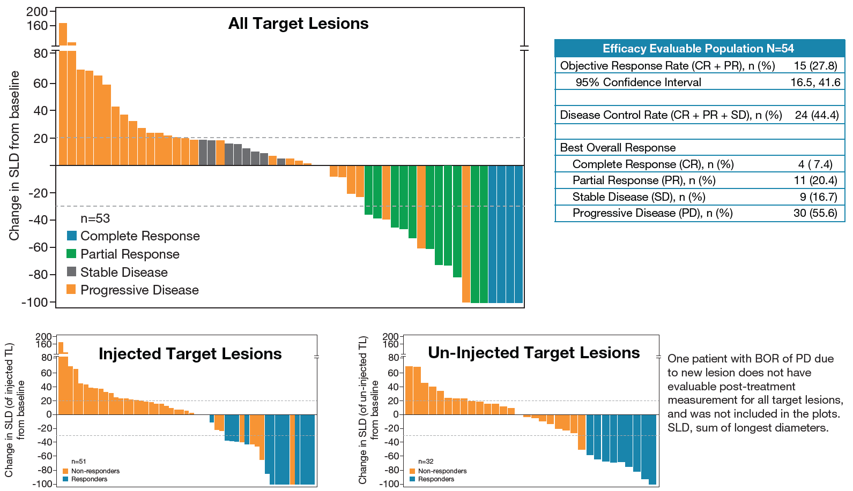
PHASE 2b: TAVO-EP + Pembrolizumab in R/R-Melanoma (KEYNOTE-695)
Investigator-assessed best reduction in target lesions
2 L Melanoma
pIL-12 EP + Pembrolizumab
Fernandez-Peñas, P. et al, SITC 2021

Slide 13
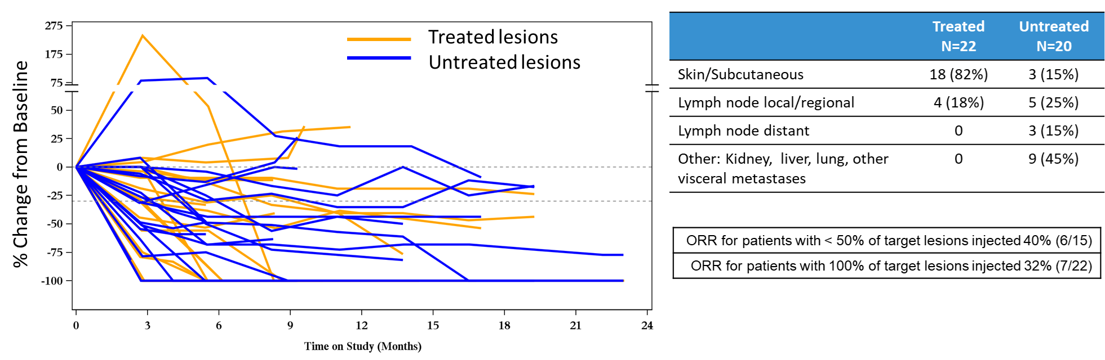
PHASE 2b: TAVO-EP + Pembrolizumab in R/R-Melanoma (KEYNOTE-695) Treated and untreated lesions in responding patients
2 L Melanoma
pIL-12 EP + Pembrolizumab
Fernandez-Peñas, P. et al., SITC 2020
Notes:
Again, in responding patients, uninjected lesions (shown in blue) responded in addition to the accessible lesions that were directly treated with TAVO-EP (shown in orange). These included cutaneous and LN lesions but also visceral disease in the kidney, lung, and liver.

Slide 14
PHASE 2b: TAVO-EP + Pembrolizumab in R/R-Melanoma (KEYNOTE-695)
Treatment-related adverse events in ≥5% of patients
2 L Melanoma
pIL-12 EP + Pembrolizumab
Category | Toxicity | Grade 1/2, n (%) | ≥ Grade 3ª, n (%) | All grades, n (%)
All |  | 40 (71.4) | 3 (5.4) | 43 (76.8)
Gastrointestinal | Nausea | 6 (10.7) | – | 6 (10.7)
 | Diarrhea | 11 (19.6) | – | 11 (19.6)
 | Abdominal pain | 4 (7.1) | – | 4 (7.1)
 | Enteritis | 0 | 1 (1.8) | 1 (1.8)
General disorders and administration site conditions | Fatigue | 15 (26.8) | – | 15 (26.8)
 | Injection site pain | 4 (7.1) | – | 4 (7.1)
 | Administration site reaction | 3 (5.4) | – | 3 (5.4)
 | Procedural pain | 13 (23.2) | – | 13 (23.2)
Infectious | Cellulitis | 2 (3.6) | 1 (1.8) | 3 (5.4)
 | Upper respiratory tract infection | 3 (5.4) | – | 3 (5.4)
Musculoskeletal | Arthralgia | 4 (7.1) | – | 4 (7.1)
 | Myalgia | 4 (7.1) | – | 4 (7.1)
Respiratory | Dyspnea | 3 (5.4) | – | 3 (5.4)
Cutaneous | Pruritus | 4 (7.1) | – | 4 (7.1)
 | Rash | 6 (10.7) | – | 6 (10.7)
 | Lichen planus | 0 | 1 (1.8) | 1 (1.8)
Investigations | AAT increased | 3 ( 5.4) | – | 3 (5.4)
ªNo grade 4 or 5 treatment-related adverse events were observed
Fernandez-Peñas, P. et al, SITC 2021

Slide 15
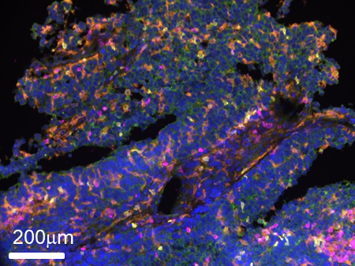
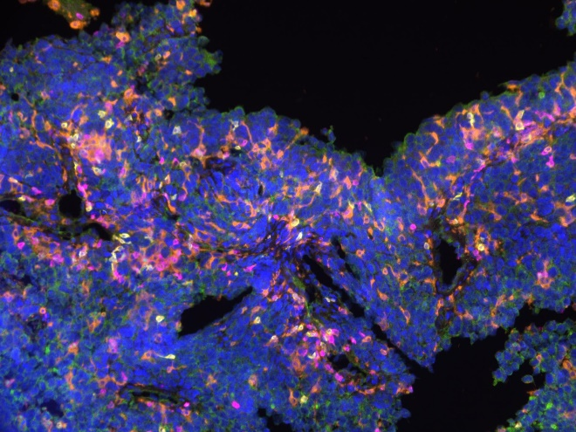
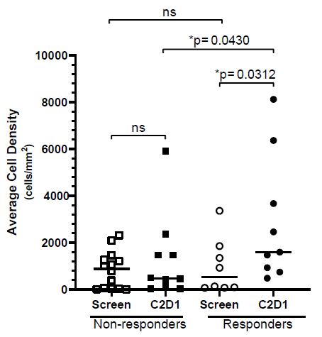
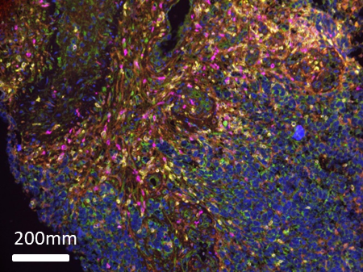
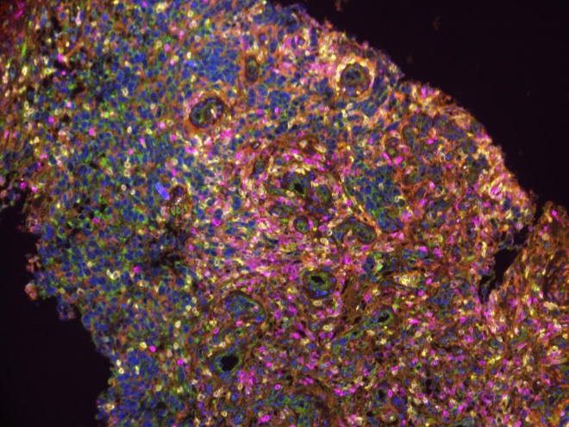
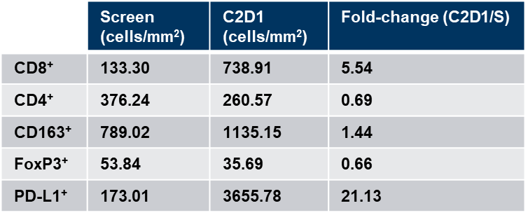
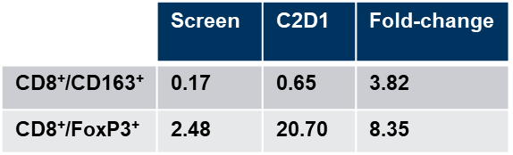
KEYNOTE-695: TAVO + Pembro can reshape the TME in responding patients
2 L Melanoma
pIL-12 EP + Pembrolizumab
SCREEN
CD8⁺ TIL (mIHC)
PD-L1 (cIHC)
C2D1
Stains:
PD-L1
CD8
FoxP3
CD3
CD163
Tumor
DAPI
Fernandez-Peñas, P. et al, SITC 2021
Fernandez-Peñas, P. et al, SITC 2020

Slide 16
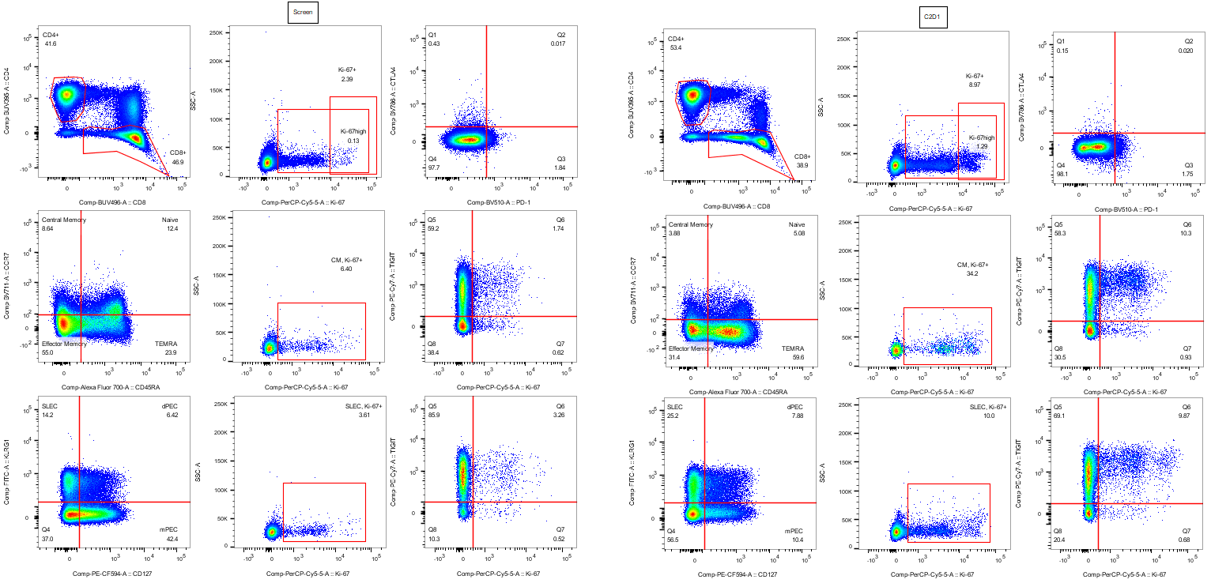
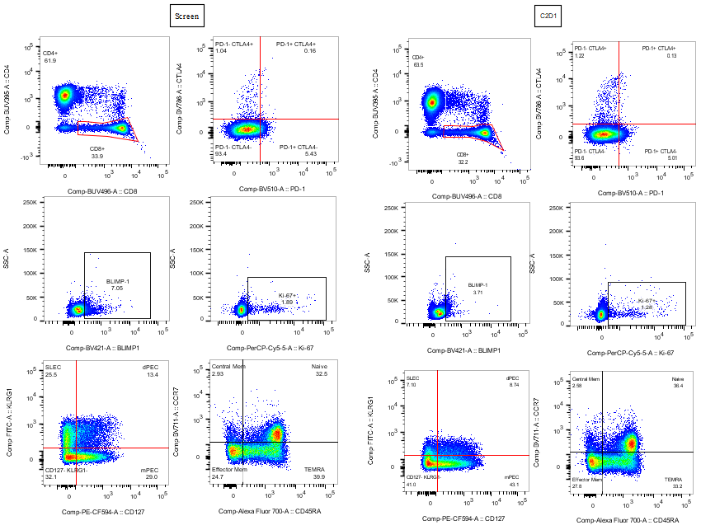
KEYNOTE-695: Changes in peripheral phenotypes support immunity beyond the treated lesion
2 L Melanoma
pIL-12 EP + Pembrolizumab
Short-lived effector cells (SLECs):
Screen
C2D1
14.2
25.2
Responding patient
25.5
7.10
Non-responding patient
KLRG1
CD127
Fernandez-Peñas, P. et al, SITC 2020
Notes:
We’re tracking many other immune correlates in the tumor & periphery, hope to share soon

Slide 17
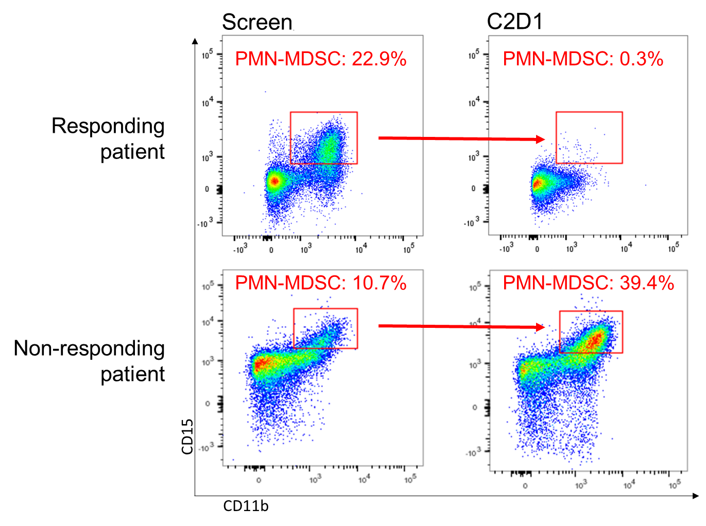
KEYNOTE-695: Changes in peripheral phenotypes support immunity beyond the treated lesion
2 L Melanoma
pIL-12 EP + Pembrolizumab
PMN-MDSCs:
Fernandez-Peñas, P. et al, SITC 2020
Notes:
We’re tracking many other immune correlates in the tumor & periphery, hope to share soon

Slide 18
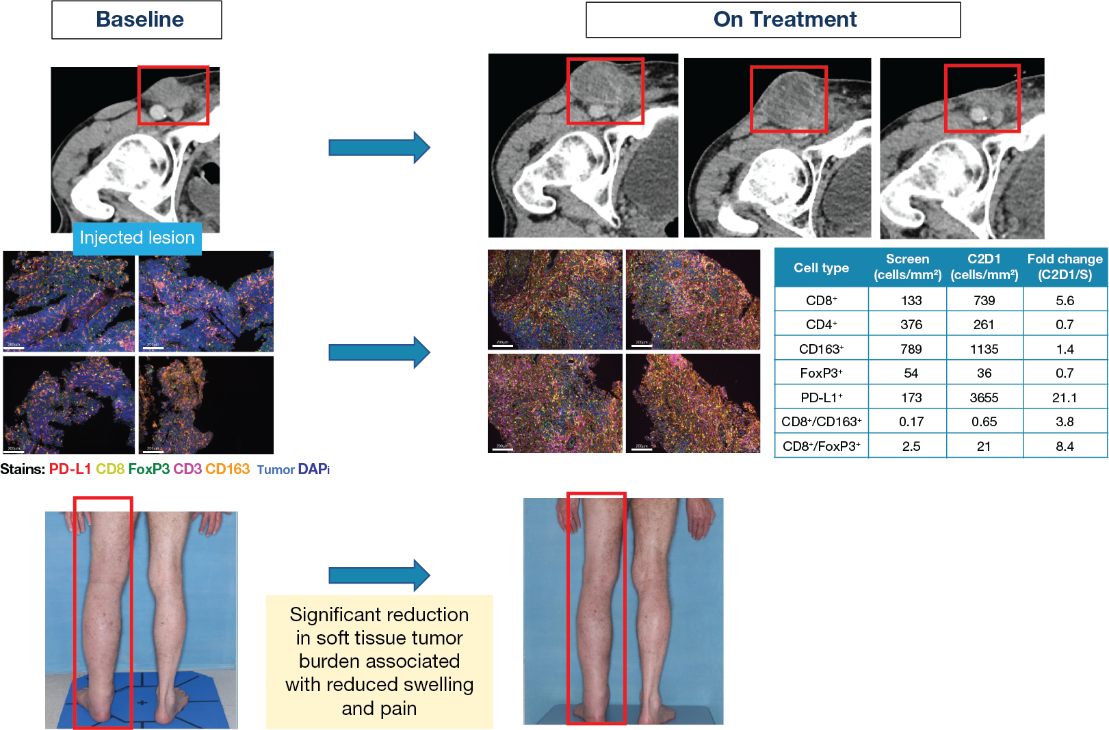
KEYNOTE-695: Flare in patient associated with positive biomarker changes
2 L Melanoma
pIL-12 EP + Pembrolizumab
71-year-old male with stage IVC disease
2 prior systemic treatments
The duration from last dose of pembrolizumab to C1D1 on KN695 trial was 1 month
Matching baseline and week 3 on-treatment tumor biopsies taken from an injected inguinal LN lesion, that increased in size, showed
5-fold increase in CD8+ T cells and productive effector:suppressor ratio in both CD163 macrophages and T regulatory cells
Best overall RECIST 1.1 response of PR
Fernandez-Peñas, P. et al., SITC 2021
Notes:
Again, in responding patients, uninjected lesions (shown in blue) responded in addition to the accessible lesions that were directly treated with TAVO-EP (shown in orange). These included cutaneous and LN lesions but also visceral disease in the kidney, lung, and liver.

Slide 19
TAVO + anti-PD-1 in patients with unresectable or metastatic TNBC

Slide 20
Summary of Prior TNBC Clinical Trials Using TAVO
(TAVO = tavokinogene telseplasmid, human pIL-12)
TAVO monotherapy in patients with stage III/IV melanoma (Telli ML, et al. SABCS 2018; Telli ML., et al, CCR 2021)
Cohort of 10 heavily pretreated patients treated with single cycle (Days 1, 5, 8) of TAVO-EP
Treatment-related increases in CD8+ TIL density, increases in cross-presenting dendritic cells and short-lived effector cells, and reduction in MDSCs were observed in some patients
Responses of injected and non-injected lesions
  Notably 1 patient who had no objective response to atezolizumab and chemotherapy responded to nivolumab following TAVO treatment

Slide 21
PHASE 2: TAVO-EP + Pembrolizumab in 2L+ and 1L TNBC (KEYNOTE-890)
Study design and conduct
TNBC
pIL-12 + Pembrolizumab ± Nab-paclitaxel
Patients
Treatment Schedule
Key Endpoints
T
T
PRIMARY ^{b}
COHORT 1: ORR by Investigator
COHORT 2: ORR by BICR^{c}
SECONDARY
COHORT 1 (by Investigator) ^{b}: DOR, PFS, DCR and iPFS, iORR based on iRECIST
COHORT 2: DOR, PFS, DCR and iPFS, iORR based on iRECIST by BICR and ORR by Investigator
OS for all subjects
EXPLORATORY ENDPOINTS
Immune monitoring correlates with responders and non-responders
Estimate of preliminary ORR in PD-L1 negative patients
COHORT 1 (N = 26)
Patients with previously treated inoperable locally advanced or metastatic TNBC
P
P
P
P
…
CYCLE 1
CYCLE 2
CYCLE 3
CYCLE 4
T
T
COHORT 2 (N = 40)ª
Treatment-naïve patients with inoperable locally advanced or metastatic TNBC
P
P
P
P
…
CYCLE 1
CYCLE 2
CYCLE 3
CYCLE 4
ªRecruiting
^{b}Based on RECIST v1.1 unless specified
^{c}Blinded Independent Central Review
N
N
N
N
N
N
N
N
N
…
CYCLE 1
CYCLE 2
CYCLE 3
T
Tavo-EP on Days 1, 5, 8 every 6 weeks (42 days)
N
Nab-paclitaxel on Days 1, 8, 15 every 4 weeks (28 days)
P
Pembrolizumab on Day 1 every 3 weeks (21 days)
Represents 1 week (7 days)
Telli ML., et al, CCR 2021
Notes:
As I mentioned earlier, we have also been conducting a clinical study of the combination of TAVO-EP and pembroliumab in patients with previously treated metastatic TNBC and TAVO-EP, pembrolizumab and chemotherapy in patients with treatment-naïve metastatic TNBC.

Slide 22
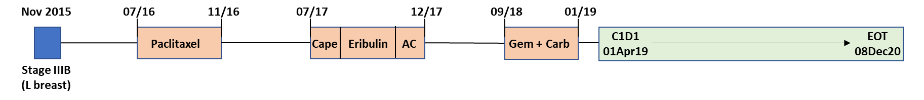
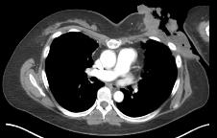
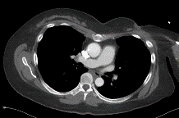
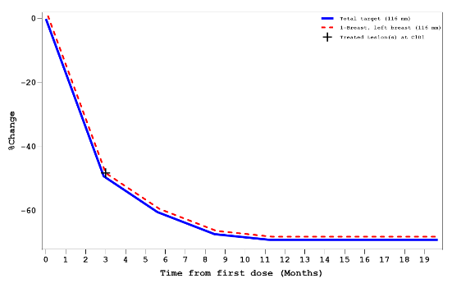
KEYNOTE-890: Response of treatment-refractory chest wall lesion
TNBC
COHORT 1
pIL-12 + Pembrolizumab
Age | Sex | Stage at Diagnosis | Metastasis | Date of last therapy dose | C1D1 | Baseline SLD (mm) | EOT | Reason | LTFU
46 | F | IIIB | Breast, Lung LN | 05Sep2018 | 01Apr2019 | 116 | 08Dec2020 | PD | Alive and disease free as of Oct 2021
LDH at Baseline | PD-L1
251 | Negative Archival (11/2015)
Mar 2019
Sep 2019
Baseline
Week 24
Notes:
Although I won’t go over the data for the overall study, I want to show you one case of a responding patient that was particularly exciting. This patient had disease progression on five prior lines of chemotherapy in the advanced, unresectable and metastatic setting. When she was enrolled into the Keynote-890 study, she had lung metastases and a large fungating chest wall mass that was causing significant decline in quality of life for the patient due to both the visual appearance of the lesion and the smell of the necrotic tissue. Following treatment with TAVO-EP and pembrolizumab, this patient had a deep response in chest wall lesion by the first tumor assessment 12 weeks after initiation of therapy, and by 24 weeks the lesion was almost completely resolved.
61-002-101

Slide 23
KEYNOTE-890: Update on Cohort 1 at SABCS 2021
San Antonio Breast Cancer Symposium 2021
  “Durable responses with intratumoral electroporation of plasmid interleukin-12 plus pembrolizumab in patients with advanced triple-negative breast cancer: Cohort 1 update from KEYNOTE-890”
  Poster P2-14-06, to be presented December 8, 2021 5:00-6:30pm

Slide 24
Beyond cutaneous indications: Evolving therapeutic platform for visceral tumors

Slide 25
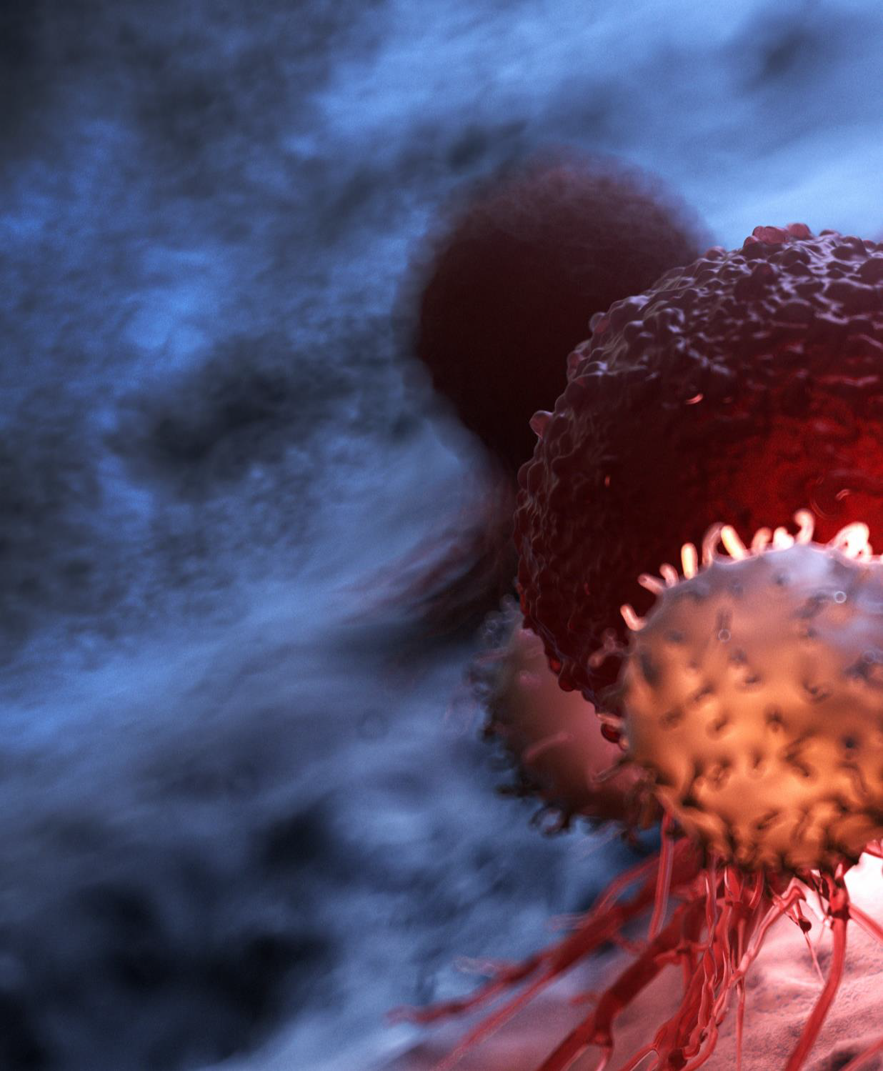

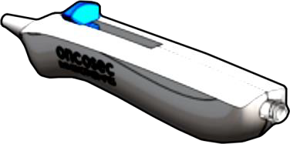
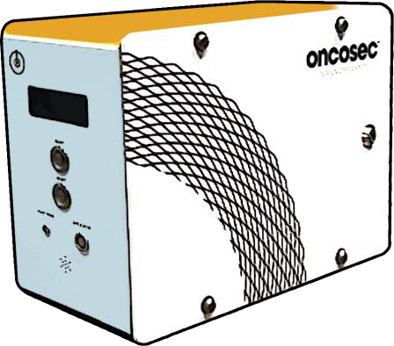
The Power of TAVO for Visceral Lesions (liver, GI, lung)
VLA: Visceral Lesion Applicator Concepts
Pioneering technology designed to target and treat tumors located
Flexible catheter- based applicator
Rigid trocar-based applicator
deep inside the body
Lower voltage
Apollo generator to be used with VLA
30

Slide 26
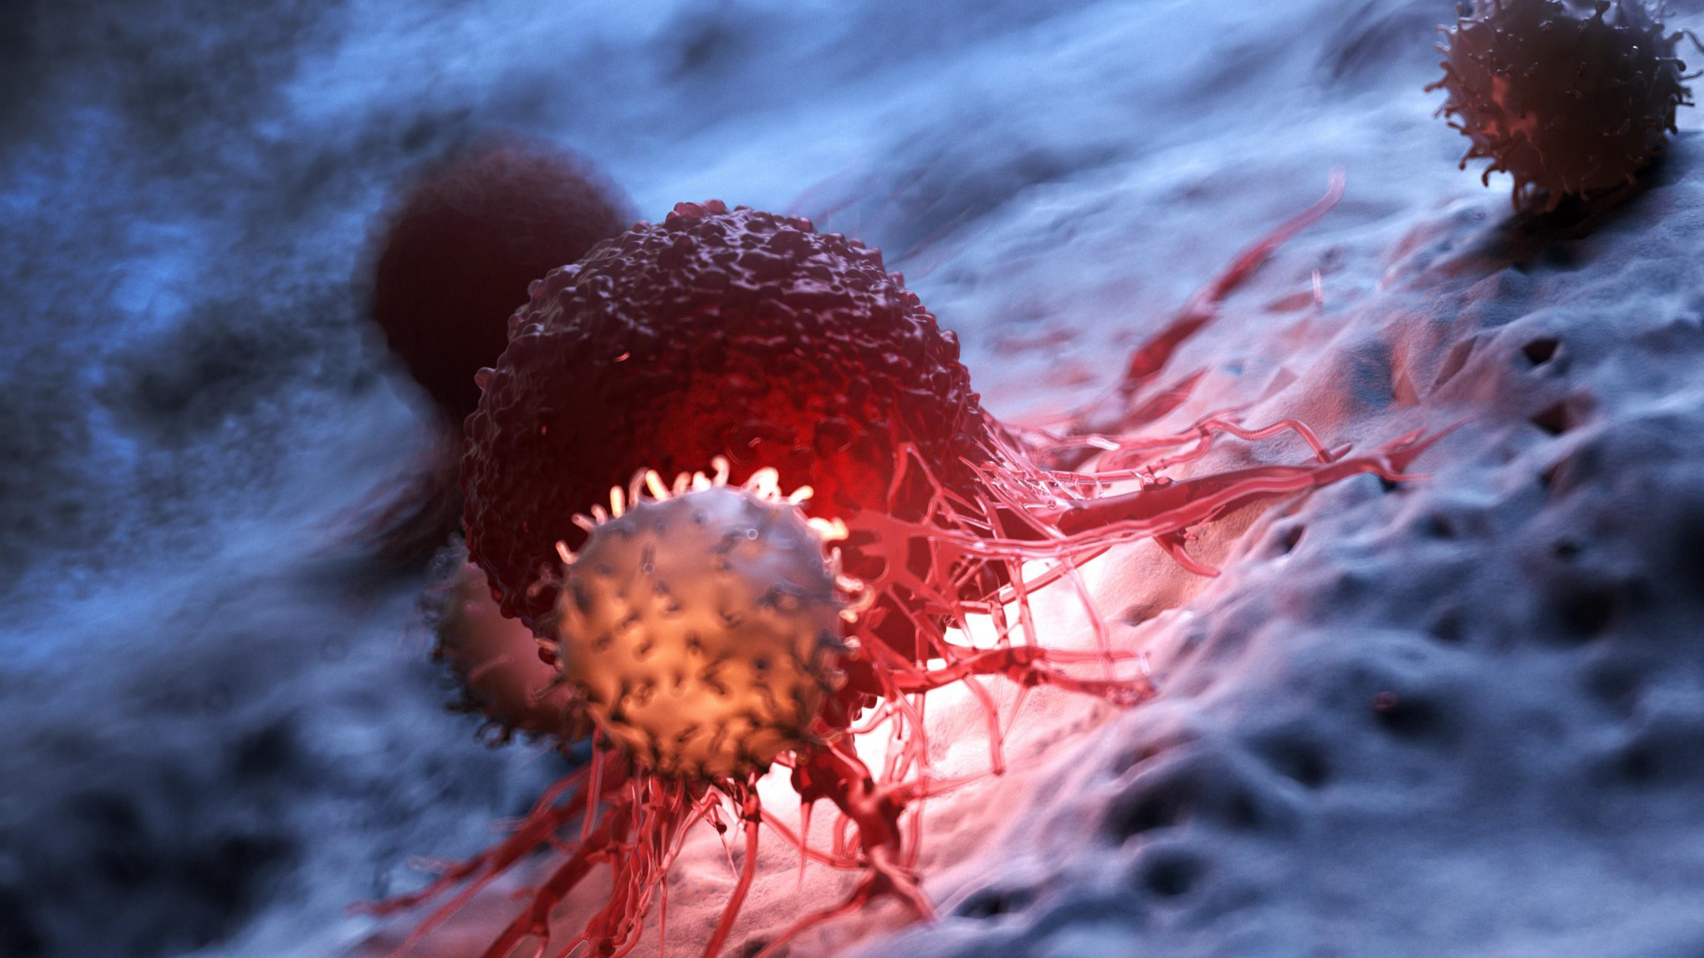
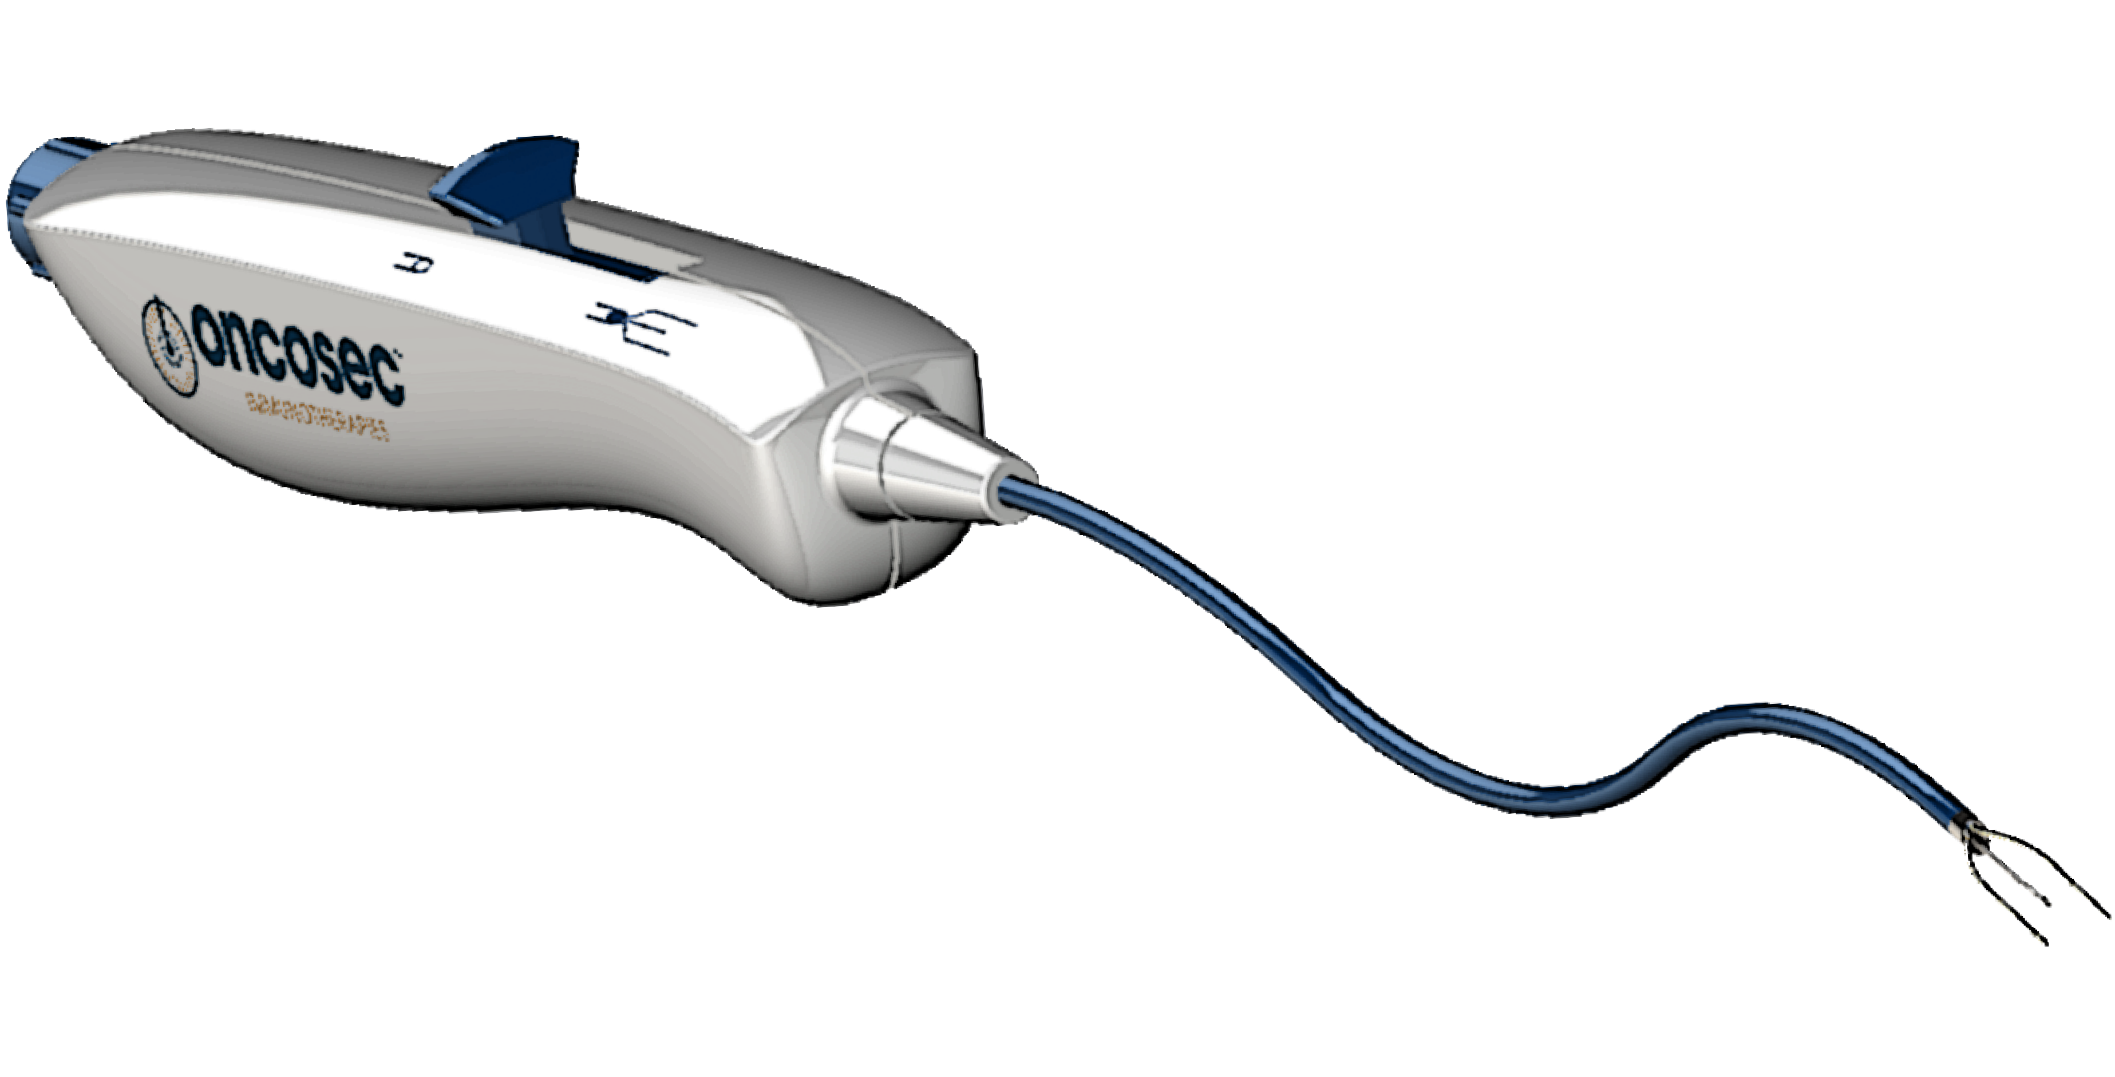
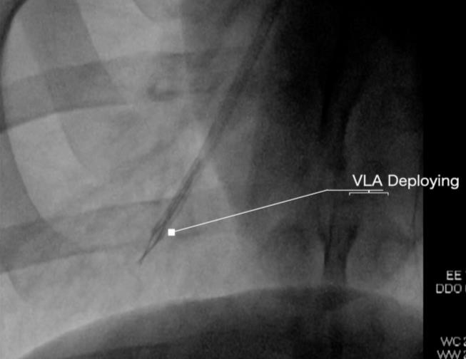
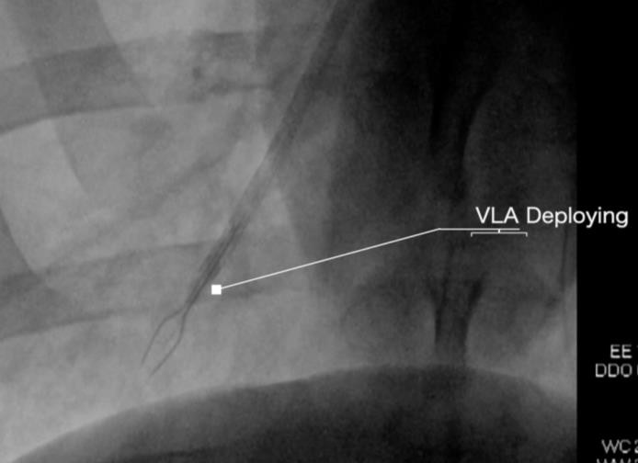
ONCOSEC CATHETER VLA (concept)
AP P L I C AB L E I N DI C A T I O N S
VISCERAL LESION APPLICATOR
Lung
BRONCHOSCOPE
Bladder
CYSTOSCOPE
GI Tract
ENDOSCOPE
AP P L I C A T O R M E AS U R EM EN T S
Electrode Width Electrode Length Injection Needle
4.5mm
8mm
(+/- 0.5mm)
May reduce length depending on application
4mm
(+/- 1mm)
(+/- 0.5mm)
Fits within 2mm working channel
4.5mm

Slide 27
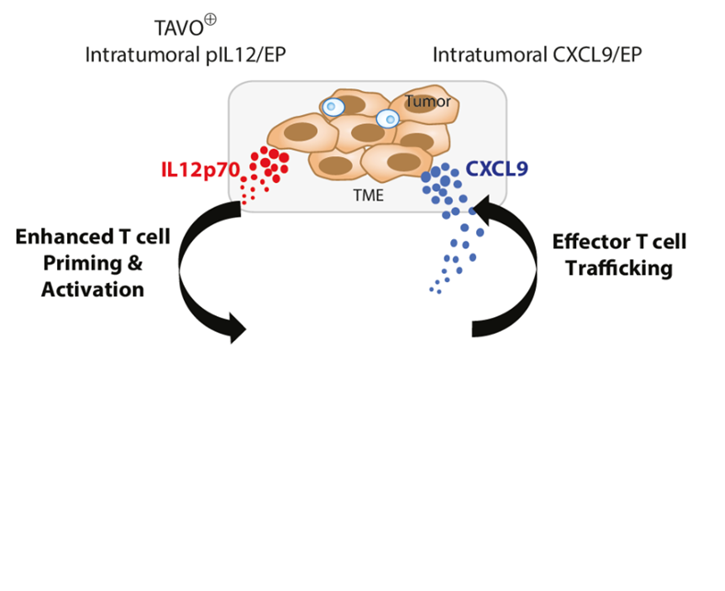

Next Generation Therapeutic Plasmids
pIL12-CXCL9
pIL12-αCD3
OKT3 scFv
hIL-12p35
P2A
hIL-12p40
P2A
hCXCL9
Igκ
V_{H} chain
G₄S
(x3)
V_{L} chain
PDGFR
TM
P2A
hIL-12p35
P2A
hIL-12p40
DLN
MUKHOPADHYAY A, et al, AACR 2020
MUKHOPADHYAY A, et al, AACR 2019

Slide 28
CONCLUSIONS
Intratumoral therapeutics can be efficiently delivered with non-viral gene therapy
Intratumoral pIL-12 (TAVO-EP) combined with pembrolizumab drives anti-tumor immune responses in patients who definitively progressed on prior anti-PD-1 therapy
This combination therapy shows minimal treatment-related toxicities
On-treatment biomarker data demonstrates that this therapy licenses immunologically quiescent tumors to yield productive local and systemic immune responses
Oncosec is working on new devices that can reach visceral lesions and second-generation nucleic acid therapeutics

